Slide 1


Toast Notifications with PowerShell: From Noob to Master Baker
Josh King
#PWSH24
@WindosNZ
@WindosNZ

Slide 2
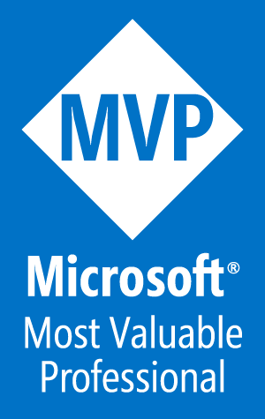
Who am I?
Josh King
TechOps Systems Administrator @ Tribe
Microsoft MVP: Cloud and Datacenter Management
 @WindosNZ  ToastIT.dev
#PWSH24
@WindosNZ

Slide 3
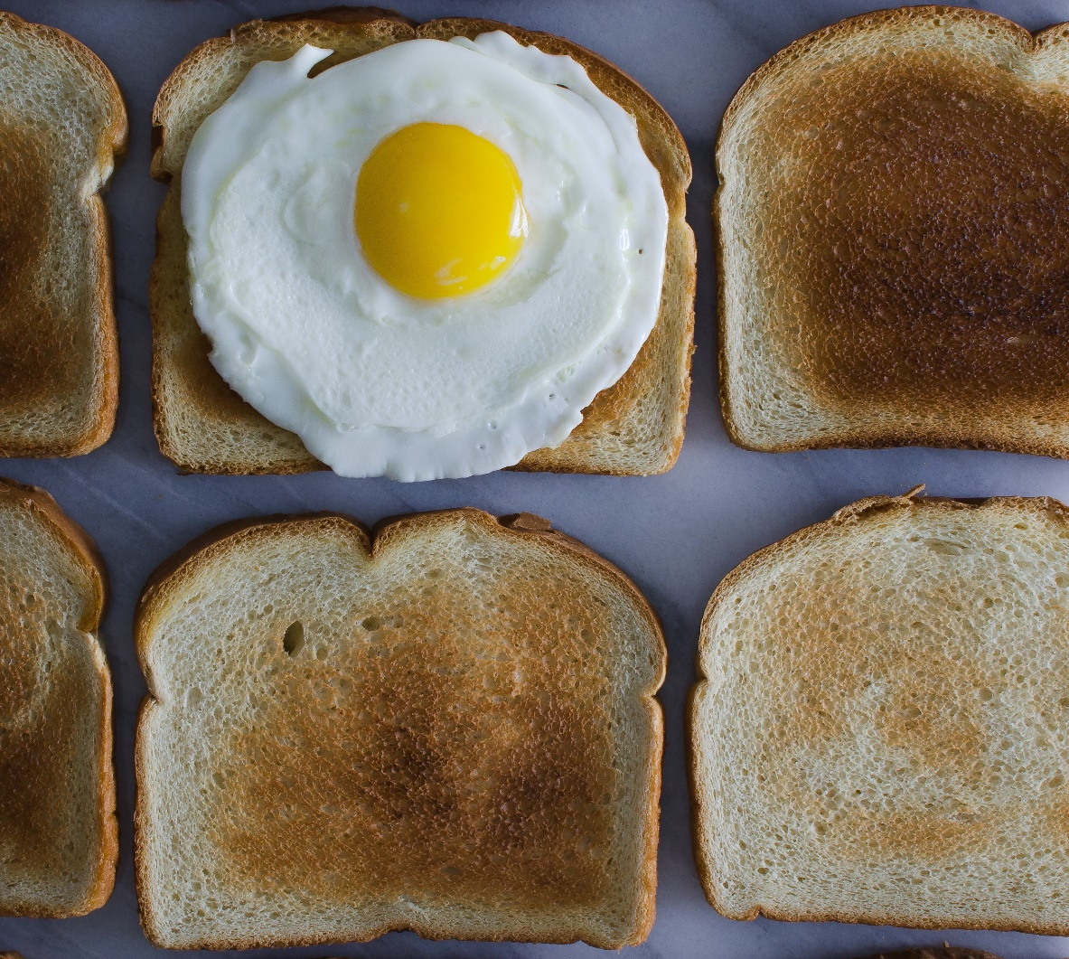
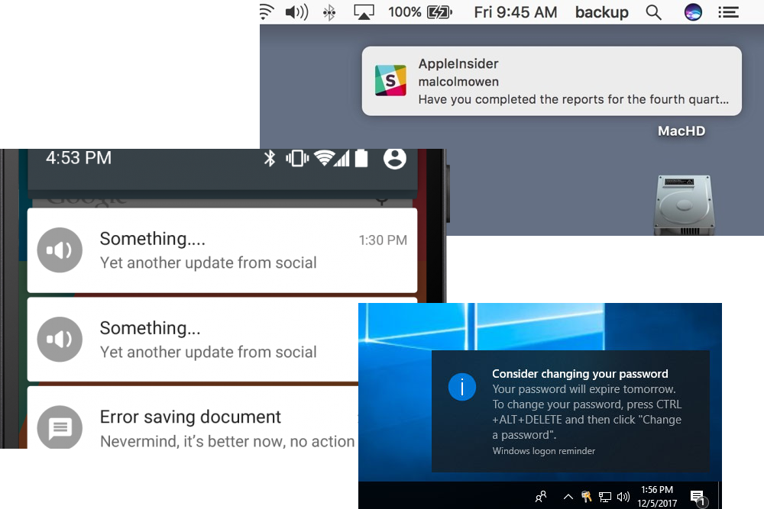
What is Toast?
#PWSH24
@WindosNZ

Slide 4

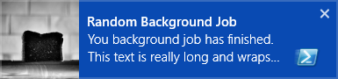
#PWSH24
@WindosNZ

Slide 5
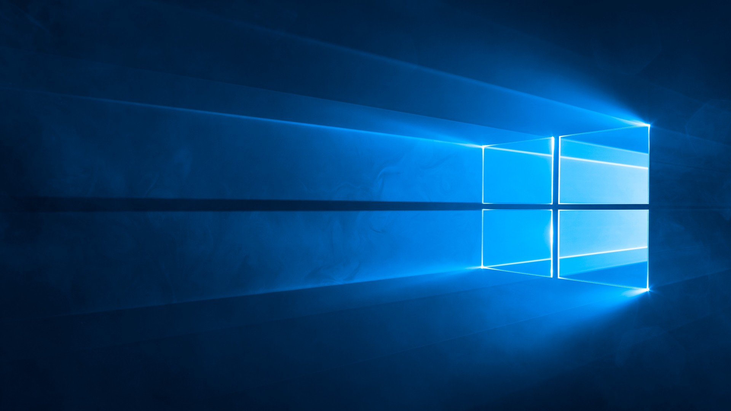
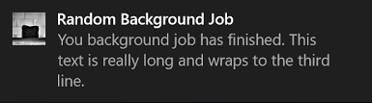
#PWSH24
@WindosNZ

Slide 6
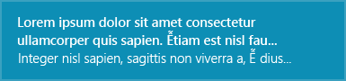

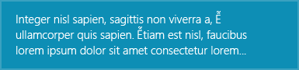

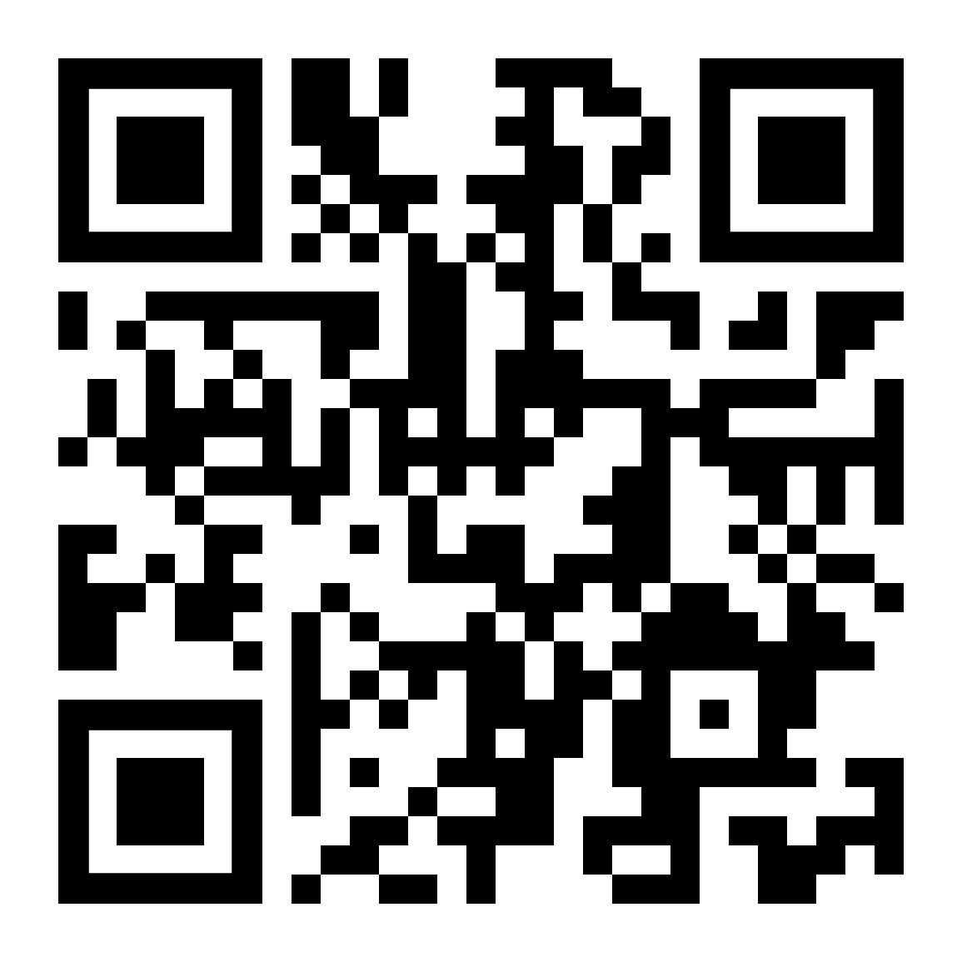
In the Beginning There Were Templates
ToastText03
ToastImageAndText04
ToastText01
ToastImageAndText02
toast.click/ToastTemplates
#PWSH24
@WindosNZ

Slide 7
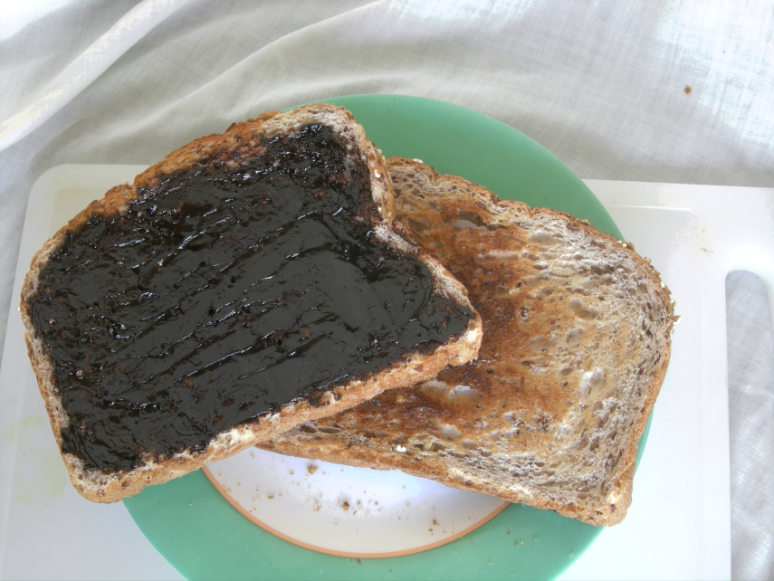
Now You Have to Be “Adaptive”…
One template to rule them all: ToastGeneric
Freedom to have your toast, your way
#PWSH24
@WindosNZ

Slide 8

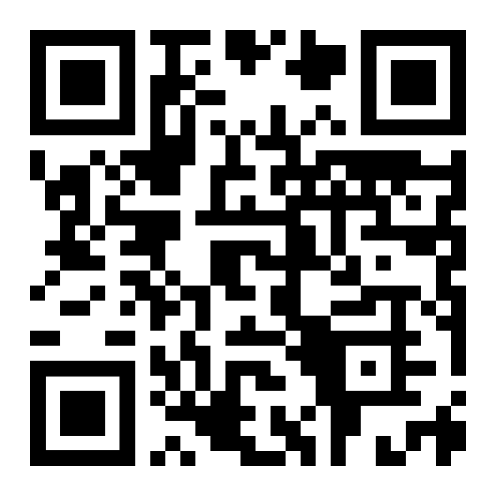
Anatomy of Toast
It’s all XML:
<toast> <visual> <binding template="ToastGeneric"> <text>Default Notification</text> <image src="C:\Images\BurntToast.png“ placement="appLogoOverride“ hint-crop="circle" /> </binding> </visual> <audio src="ms-winsoundevent:Notification.Default" /> </toast>
toast.click/Anatomy
#PWSH24
@WindosNZ

Slide 9

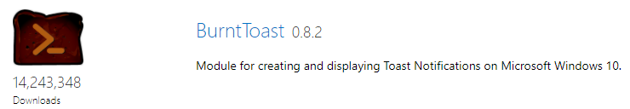
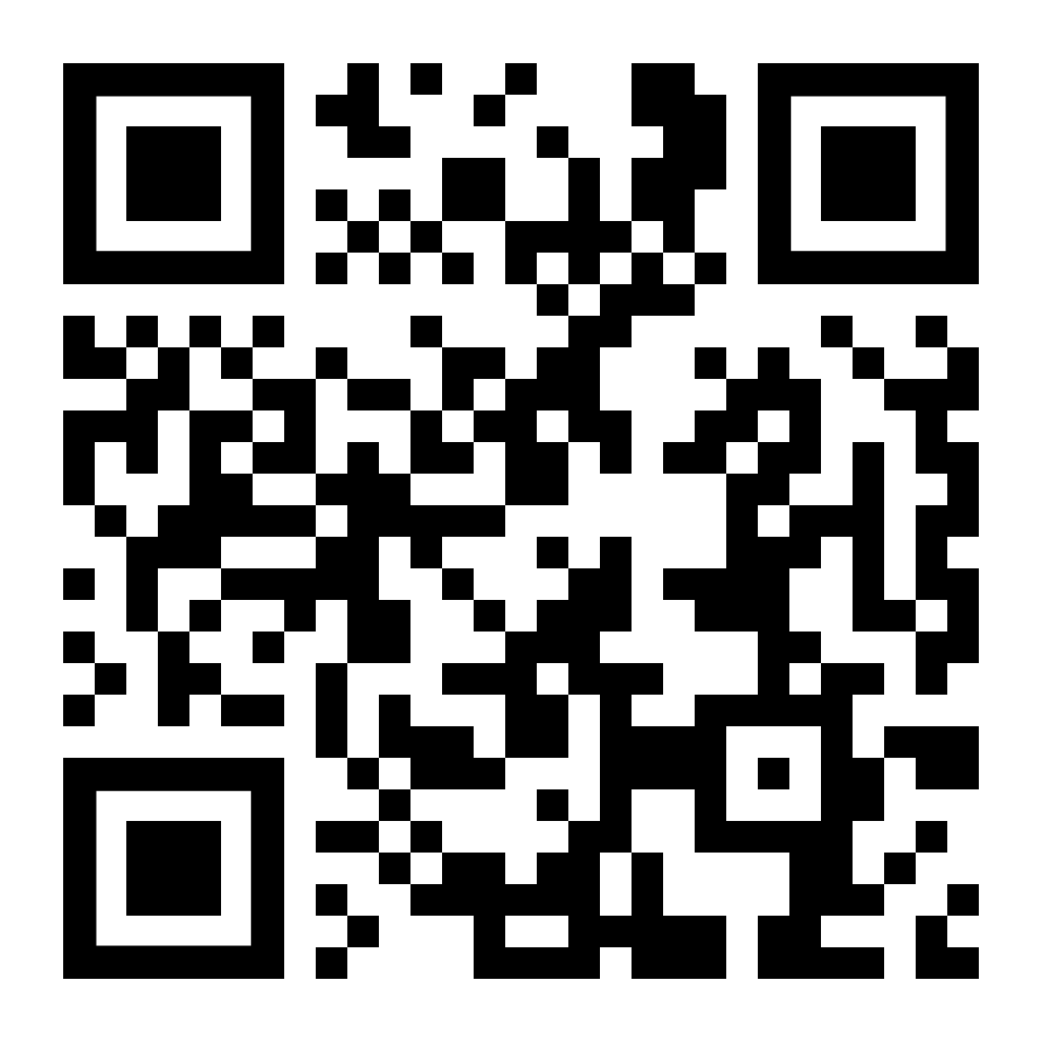
What’s This BurntToast Thing?
toast.click/psgallery
#PWSH24
@WindosNZ

Slide 10





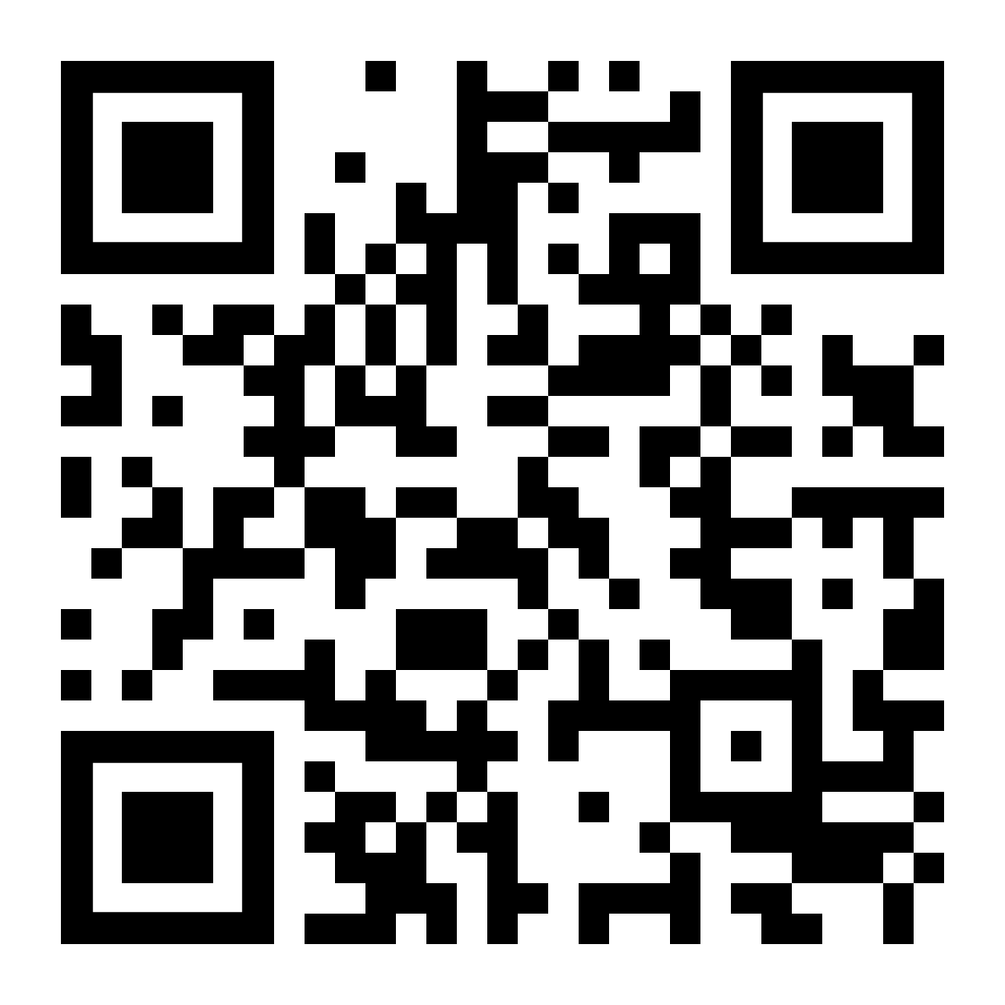
So… Why?
toast.click/NoBurntToast
Icons made by Eucalyp from www.flaticon.com
#PWSH24
@WindosNZ

Slide 11
Demo
#PWSH24
@WindosNZ

Slide 12
Takeaways
It’s all XML
You don’t need to touch XML
Leverage the UWP Windows Community Toolkit to roll your own
Use BurntToast
Let me know your use cases!
#PWSH24
@WindosNZ

Slide 13
Thank You!
toast.click/Talks
@PSHSummit
@PSConfAsia
@PSDayUk
#PWSH24
@WindosNZ

